Slide 1
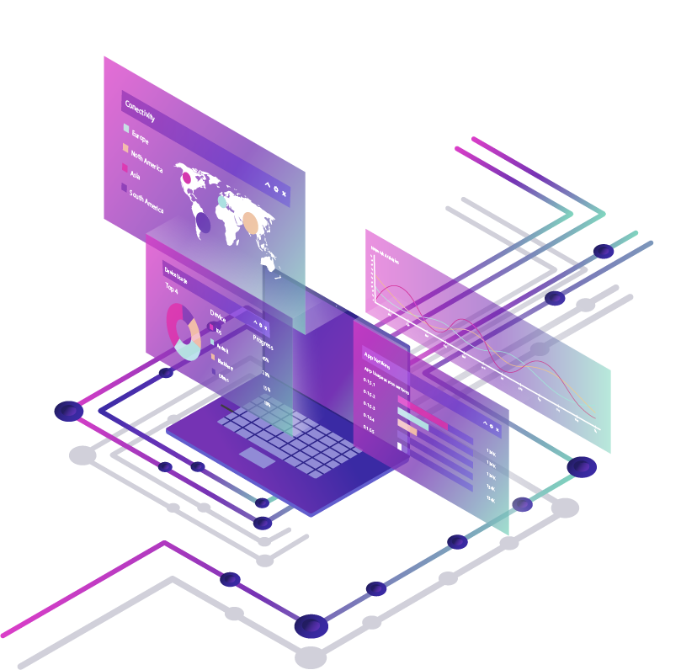
IMD 311 Introduction To Web Content Management and Design
Hanin Nur Deeni bt Hasnor | 2017750301
Nur Kasih bt Azahar | 2017500725
Nurin Shafiqah bt Mohd Fikri | 2017339609
Siti Nur Adriana Sofia bt Mohd Zahini | 2017324361

Slide 2
01
02
03
BACKGROUND
NATURE BUSINESS
UX / UI
TABLE OF CONTENTS
04
05
06
COLOR SCHEME USE
NAVIGATION
CONTENT

Slide 3
INTRODUCTION
- Ministry of Health was one of the important government sectors in Malaysia.
- This government organization sector also has launched their own application called as “myHealth KKM”.
- Ministry of Health motto was “We're Ready to Help” .
- The minister that is responsible is Dato' Seri Dr. Noor Hisham bin Abdullah who has served as the Director-General of Health since March 2013.
- Even though MOH website are not as modern as the other website, the information given were updated and all the information are easy to understand.

Slide 4
01 BACKGROUND
- Website is a platform that web pages and related content that is identified by a common domain name and published on at least one web server.
- Ministry of Health Malaysian using their website domain name as in moh.gov.my. It is because Ministry of Health Malaysia was under the government sector.
- Programming used are PHP, Apache, Google Analytic, j Query, j Query UI, j Query Migrate.
- This website was public to all server for using it , but apparently this website was totally secured by MAMPU.

Slide 5
02 NATURE BUSINESS
- This website is also one of the online sources of Ministry of Health Malaysia information updates for any kind of information that are related to health to spread the awareness of the importance of taking care personal health.
- This is to let the person knows how to took care their own health without even going to the hospitals.
- The purpose of the website is to provide information about medical and health and updates about any current issues that are related to health care that was happening around the globe everyday.
- The information provided by the MOH will be either in diagrams or in article form. MOH used various types of ways to deliver information to the user which is in a form of diagrams or even in a form of articles.

Slide 6
03 UX UI
- User experience (UX) is the interaction and experience users have with a company's products and services. User interface (UI) is the specific asset users interact with.
- The website of Ministry of Health Malaysia doesn’t really have product but the website is more about services, healing, ways & tips, corporate information, directory, publications, career, archives, questions & answers and contacts.
- The content of the website is interesting and if any of the users are blind colors, they can choose the colour of the fonts.
- If there is any complaints or feedback about the website, the users can contact them for any feedback.

Slide 7
04 COLOR SCHEME USE
- Ministry of Health Malaysia, from what we can see they are using Monochromatic colour scheme.
- They are really easy to manage, as there are no more decisions to be made concerning colour.
- Website Ministry of Health Malaysia are using blue colour to show more of relaxing and calming since the information are about health in Malaysia.
- Every time someone visit the website to find any information about the health at Malaysia, they can feel the relax and calming colour of blue.
- Blue is considered beneficial to the mind and body.

Slide 8
05 NAVIGATION
• Movement that makes an easy way for the visitors to go to the next page.
• Invented by Timothy Berners-Lee and Ministry of Health itsefl.
• Make an easy and quick for the visitors to spend their time to go to the another page.
• Should be on standard place.
• Will use the navigation to go to through the webpages that Ministry of Health has.
• The navigation can assist the visitors through all the web pages by looking on what that they need the information

Slide 9
06 CONTENT
• The website has been develop by Ministry of Health Malaysia
• It is about medical and health and they are using both types of content which is text and multimedia.
• Content of the website is on every web page and the visitors need to know what information they are searching on.
• The visitors will use the content of the website when they visit the Ministry of Health Malaysia website.
• It helps and educate people about surfing the website and the content need to be accurate with the containe information.
• The content of the website is not fully organized and they use the right languages to inform the information to their visitors

Slide 10
CONCLUSION
- In conclusion, the website Ministry of Health Malaysia should improve their website by make it more modern and according to latest website.
- Other than that, not too full of information make it simpler but the information is thorough, reliable, and complete.
- Ministry of Health Malaysia website should improve their presentation, button, and icons with the latest version and more modern since its already year 2020, and most of the users are attracted to simple websites.
- The visitors are able to access and get the information and the navigation that they use is at standard place and simple.

Slide 11

THANK YOU !
Does anyone have any questions?

